Slide 1




Brazilian House Rent price
Jean-Denis Drané
Safa Eladib

Slide 2


01. Introduction
02. Process
03. Conclusion

Slide 3

Context
Our analysis deals with brazilian houses to rent.
We are trying to find a linear regression between the rent amount and other features available in the dataset obtained from Kaggle.

Slide 4
PROCESS
STEP1
STEP2
STEP3
STEP4
Acquisition and preparation
Of Data
Visualization and exploration of Data
Modeling linear regression
Checking assumptions and conclusions

Slide 5

DATA PREPARATION
Renaming columns
Creating dummies
For furniture and animal acceptance features

Slide 6
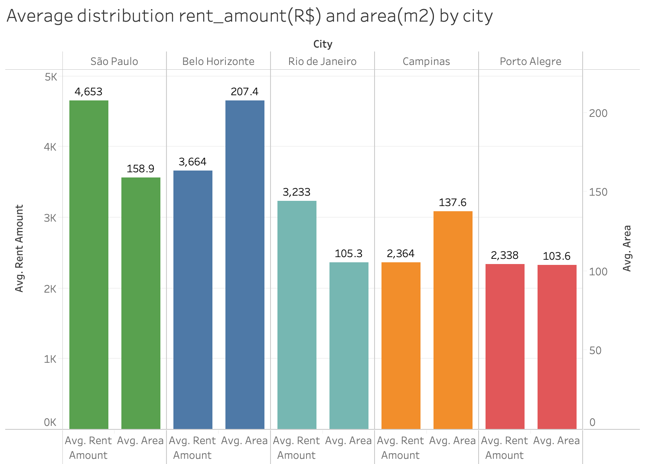
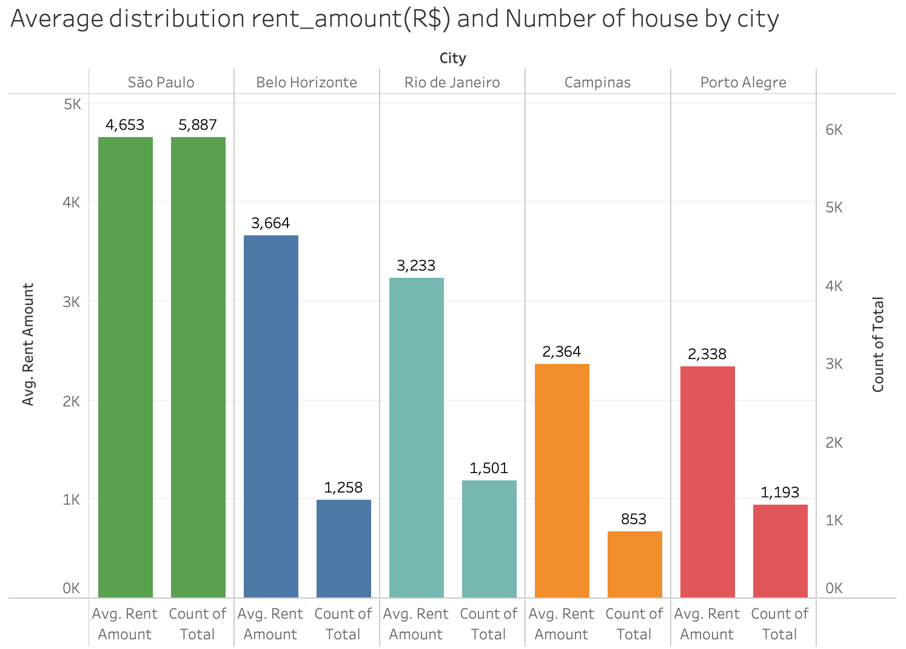
VISUALIZATION
The cities in our dataset seems to be very different in terms:
Amount of rent
Average area
Number of house available

Slide 7
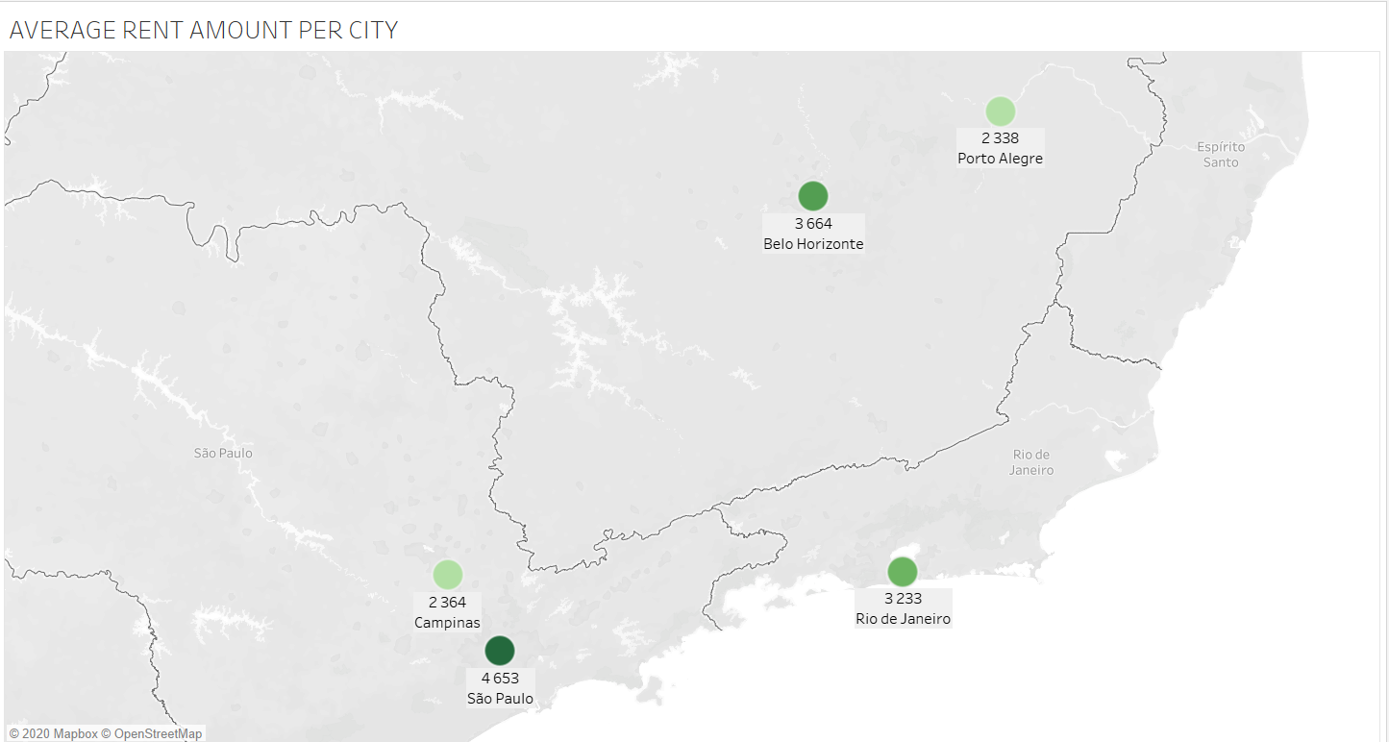
VISUALIZATION
Mercury is the closest planet to the Sun and the smallest one in the Solar System—it’s only a bit larger than our Moon
Notes:
We can see, obvsiouly that the average of the rent cost vary from one city to another

Slide 8
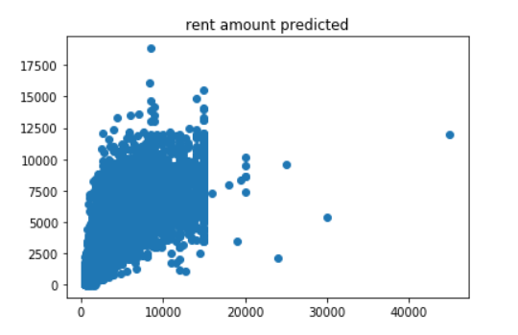
MODELLING
First attempt of modelling the dataset lead us to this graph of the predicted rent cost
The predicted rent amount does not follow a linear regression.
The disparity of average rent amount between cities can explain this gap.
Seperate the study of dataset by cities.

Slide 9
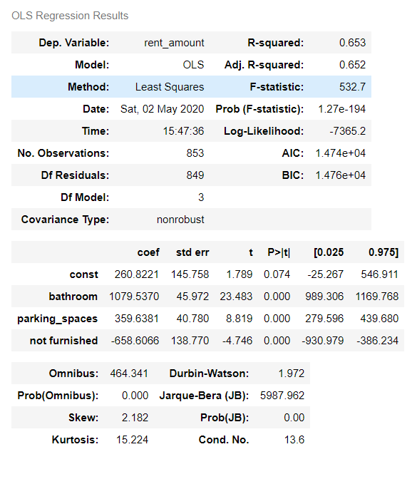
STUDY CITY: CAMPINAS
The regression that we are looking for, is the linear regression.
We are using OLS model to do our modelling.
Based on this model, we can deduce that the rent price in campinas depends specially on:
number of bathrooms
Parking spaces
furnishing
Notes:
First city to analyse is campinas.
- Based on this model and after doing p-hacking

Slide 10


CHECKING ASSUMPTIONS
Multicollinearity
Autocollinearity
Linearity
Homoscedasticity
Exogeneity
Notes:
Once we built the OLS model, let’s check the gauss markov assumptions.

Slide 11
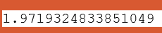
CHECKING ASSUMPTIONS
MULTICOLINEARITY:
The calculation of the Variance inflation factor for those 3 features give us:
Values that are less than 10. So the assumption of no multicollinearity is satisfied
AUTOCORRELATION:
Durbin Watson test result
Value is between 1.5 and 2.5 so there is no autocorrelation, so assumption satisfied
Notes:
To check the multicolinearity: we should demonstrated it,mathematically, by calculating the variation inflation factor.

Slide 12
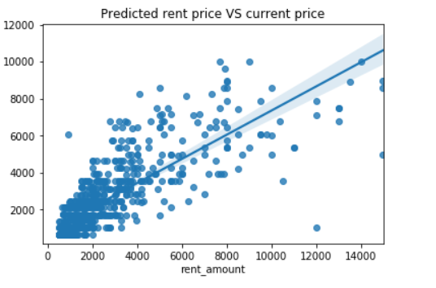
CHECKING ASSUMPTIONS
LINEARITY:
The predicted rent amount tends towards the diagonal line. Except some outliers.
Assumption is potentially satisfied.

Slide 13
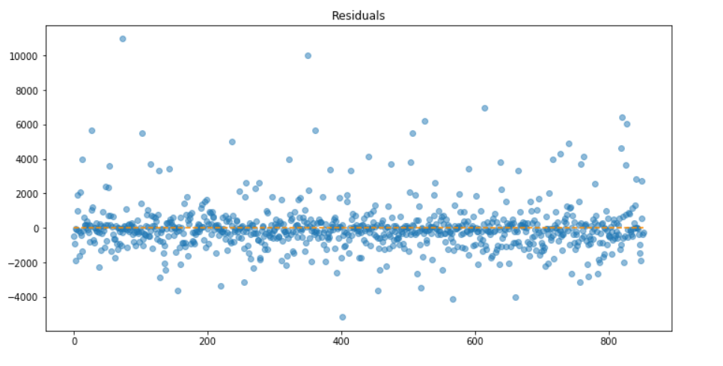
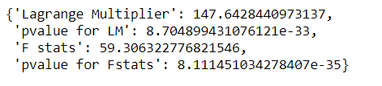
CHECKING ASSUMPTIONS
HOMOSCEDASTICITY:
The plot of the representation of total residuals, shows us, approximately, a constant variance of residuals.
Except outliers that are very present in our dataset.
Diving deeper in this check, the calculation of het breuschpagan parameters gives us this result
Positive autocorrelation so potentially, this assumption is violated
Notes:
We can deduce that there are signs of positive autocorrelation

Slide 14
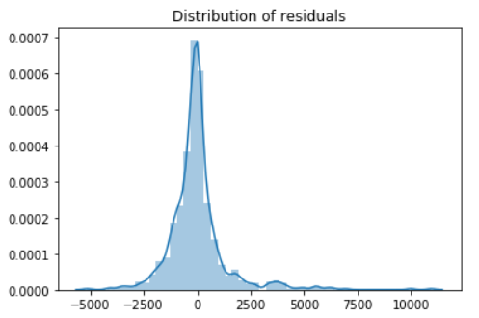
CHECKING ASSUMPTIONS
EXOGENEITY:
As we saw in the previous graph and this one, that the average of the residuals is around 0, almost a normal distribution.
Additional tests like KStest and Anderson-Darling test shows us that residuals are not normally distributed.
That’s why, this assumption may be violated.

Slide 15
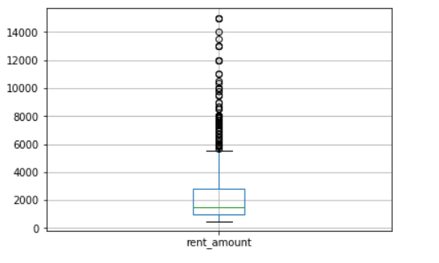
CONCLUSION STUDY CAMPINAS CITY
The Outliers in our dataset are very present and that affect widely the accuracy of our analysis.
At this stage of the study we cannot infer that the house rent price in campinas follow a linear regression because the Gauss Markov assumptions are not entirely met.
So our Ordinary Least Squares Model does not allow us to have the Best Linear Unbiased Estimate (BLUE) of the brazilian house rent price..
Possible improvement is to change the experiment setup to make our situation fit the assumptions more closely.
Notes:
That’s why, for the case of campinas, we will clean our data from outliers and see the impact on the model

Slide 16
QUICK COMPARAISON OUTLIERS VS. WITHOUT OUTLIERS
The modelling of our dataset without outliers gives us a model with a lower Akaike information criterion AIC. So potentially, this model minimizes the estimated information loss.
WITH OUTLIERS | WITHOUT OUTLIERS
MULTICOLINEARITY: STATISFIED | MULTICOLINEARITY: VIOLATED (1 case of possible multicolinearity among predictors)
AUTOCORRELATION: STATISFIED | AUTOCORRELATION: STATISFIED
LINEARITY:POTENTIALLY SATISFIED | LINEARITY: POTENTIALLY SATISFIED
HOMOSCEDASTICITY: VIOLATED | HOMOSCEDASTICITY: VIOLATED
EXOGENEITY: VIOLATED | EXOGENEITY: VIOLATED
Notes:
After removing outliers, assumption still not met perfectly. Eventually, processing nonlinear transformation or looking for other type of regression.

Slide 17
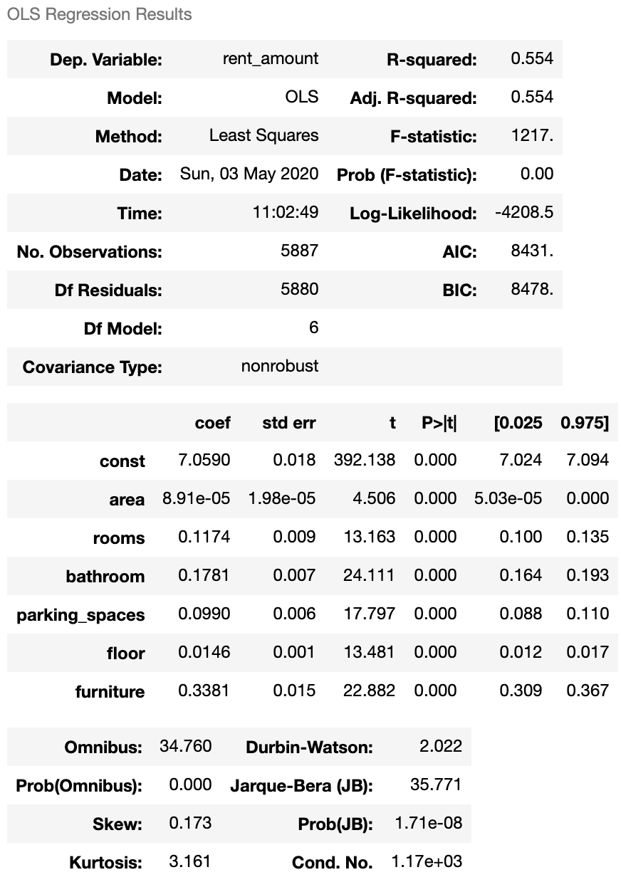
STUDY CITY: SAO PAULO MODEL
Model with LOG : y=np.log(‘rent_amount’)
P-hacking led us again to remove the feature :
animal
The model shows that the Rent amount depends on 6 features :
Area
Rooms
Bathroom
Parking space
Floor
Furniture

Slide 18
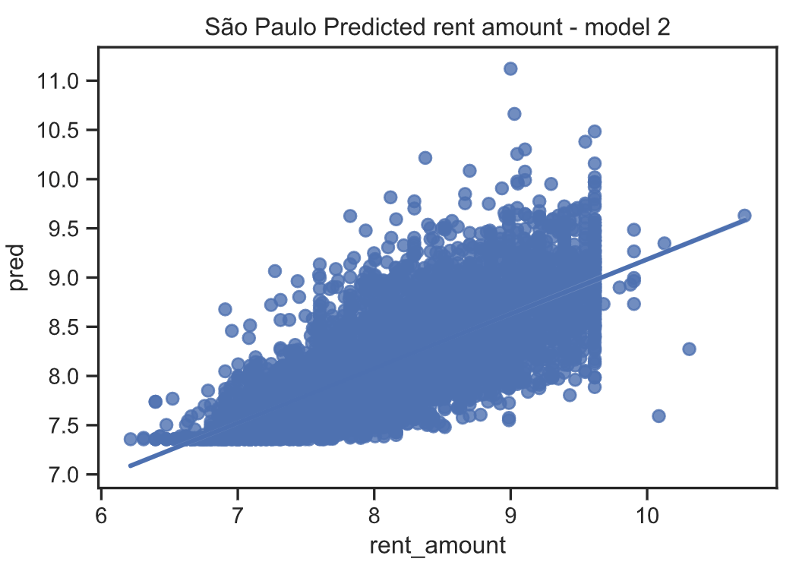
SAU PAULO - CHECKING ASSUMPTIONS
LINEARITY potentially satisfied :
We can see a potential linearity, but the outliers most likely still impact our dataset

Slide 19
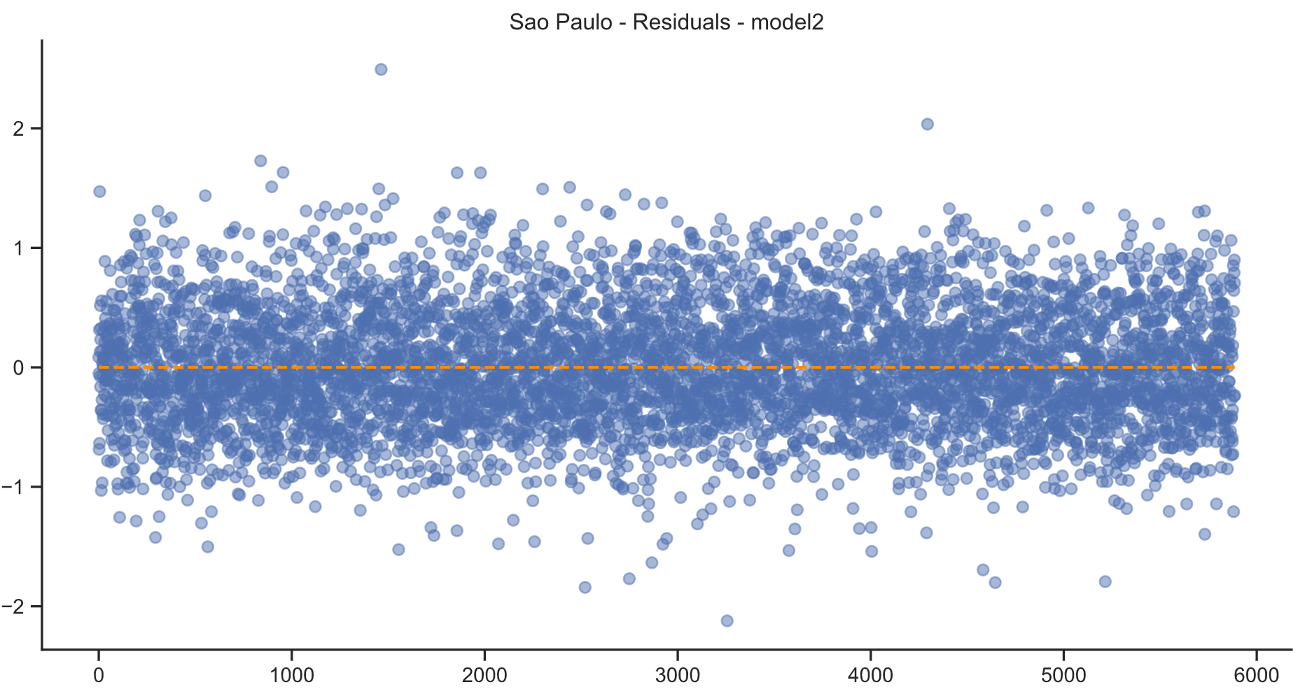
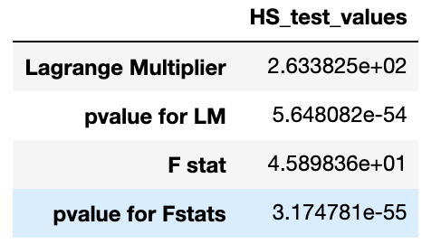
SAU PAULO - CHECKING ASSUMPTIONS
HOMOSCEDASTICITY not satisfied:
Data standardized
Het Breusch Pagan test confirmed it:
Null hypothesis rejected cause both p value for LM and F stats are close to 0.

Slide 20
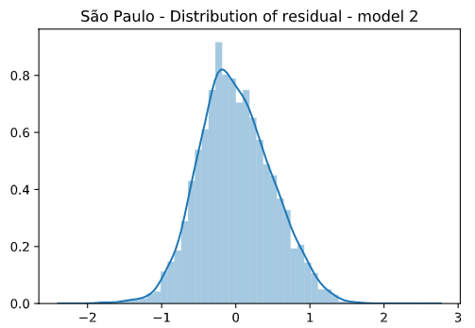
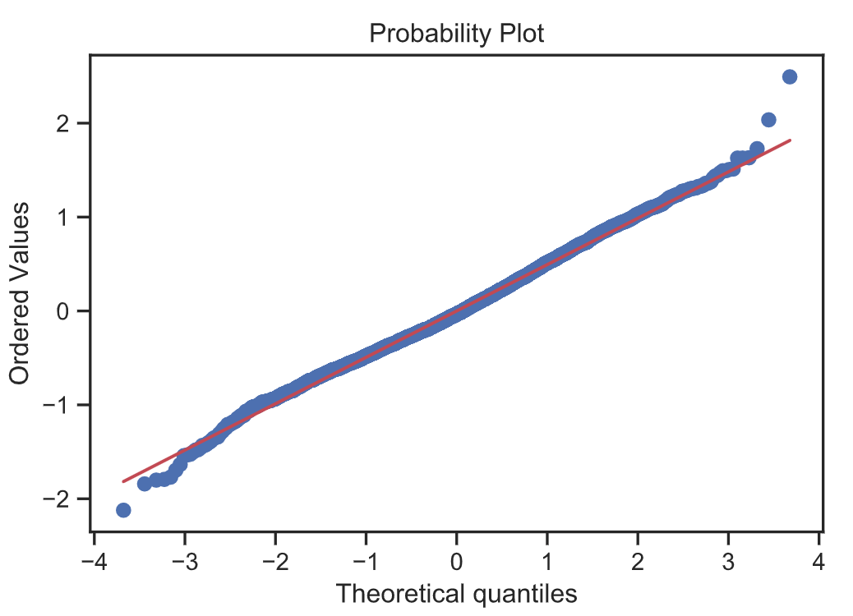
SAU PAULO - CHECKING ASSUMPTIONS
EXOGENEITY not satisfied
The LOG distribution looks like a normal distribution, but KS test returned a low ‘p value’: normality rejected

Slide 21
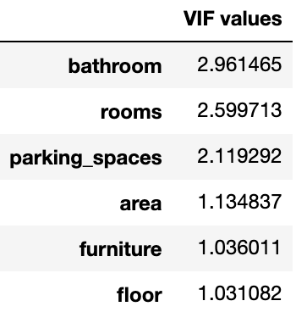
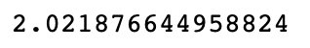
SAU PAULO - CHECKING ASSUMPTIONS
MULTICOLLINEARITY satisfied
The calculation Variance Inflation Factor shows us that 6 features in the model a value smaller than 10,.
So they are alright to be keeped.
AUTOCORRELATION is satisfied
Durbin Watson test validated, no autocorrelations found

Slide 22
CONCLUSION STUDY SAO PAULO CITY
Multicollinearity - satisfied. LOG approach seems to be good model.
No autocorrelation - satisfied. Durbin-Watson test validated.
Linearity - potentially satisfied. with this updated model, we get closer to the linearity of the data. But it seems that we can do better by handling the outliers.
Homoscedasticity - not satisfied. As linearity: need to handle the outliers
Exogeneity - failed. Same statement: handle outliers
We still need to improve the modelisation for Sao Paulo to prove that there is a linear regression related to its data.
However, we can use this model to describe the relationships between the variables.

Slide 23


THANKS
for your
attention!

